Slide 1
Fall 2018 Group Project
Alex LeBoeuf, Joshua Appenzeller
Leutrim Dema, Katarina Gomez

Slide 2
Starbucks
Menu
Apply
Nutrition
Members
Alex – UML Diagrams, Apply tab
Joshua – Order tab functionality, Calculate button, Output file
Leutrim – GitHub, Order tab functionality, Notebook container, Output file
Katarina – UML Diagrams, Nutrition tab, presentation

Slide 3
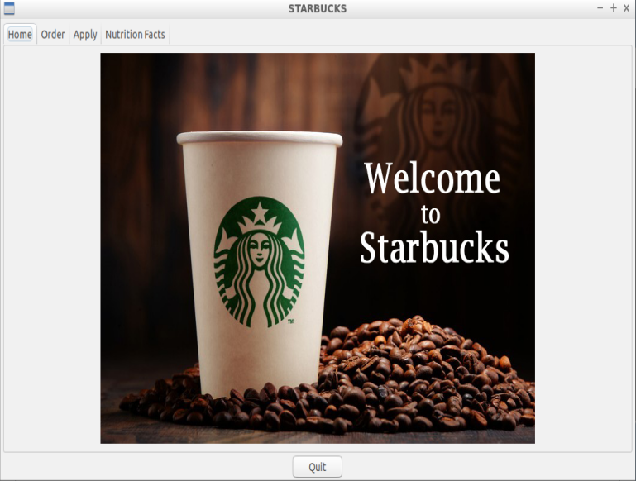
Menu
Apply – apply for position
Order – order drink
Nutrition – view nutrition facts for drinks

Slide 4
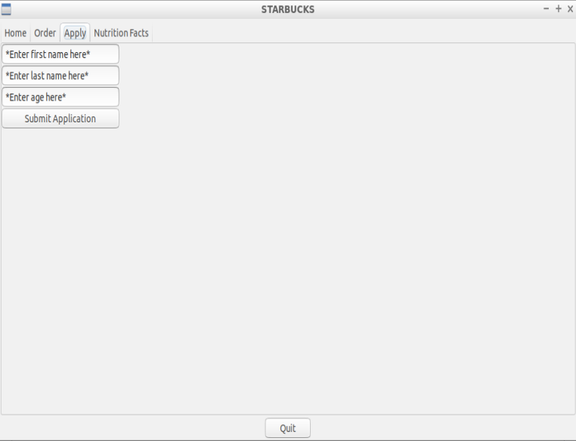
Apply
Apply for position
Outputs file with application

Slide 5
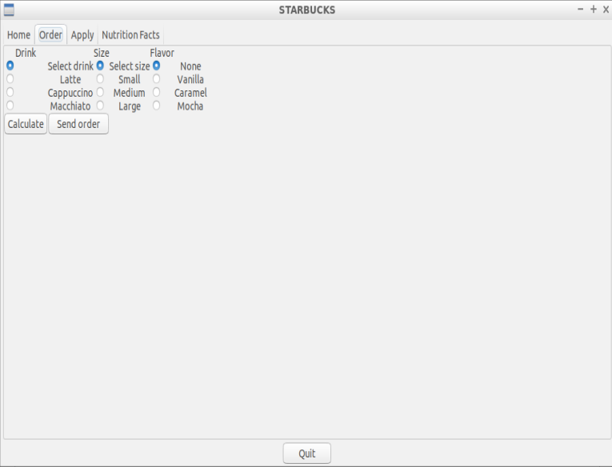
Order
Order drink
Latte, Cappuccino, or Macchiato
Select size and flavor option
Calculate
Displays final price
Send Order
Outputs orders to file and calculates total profit
Return
Return drink if not satisfied
Give your Barista a High Five!

Slide 6



Nutrition
View Nutrition Facts for each drink
Latte
Cappuccino
Macchiato

Slide 7
UML Diagrams
Class Drink
protected:
float price; //price
string add; //added flavor
char size;//size
public:
Drink);
float price();
Class Latte: public Drink
public:
Latte(string add, char size)
this->add =add;
this->size = size;
this->price = 3.00 //base price
float price()
//returns price dependent on size and flavor

Slide 8
Class Capp: public Drink //shares similar functionality as Latte
Class Macchi: public Drink //share similar functionality as Latte
Class Employee
vector<string>barista; //setting names of Baristas to call on
bool hi5; //high five status
Class Customer
string name; //ask for name for coffee order
bool hi5; //high five status

Slide 9
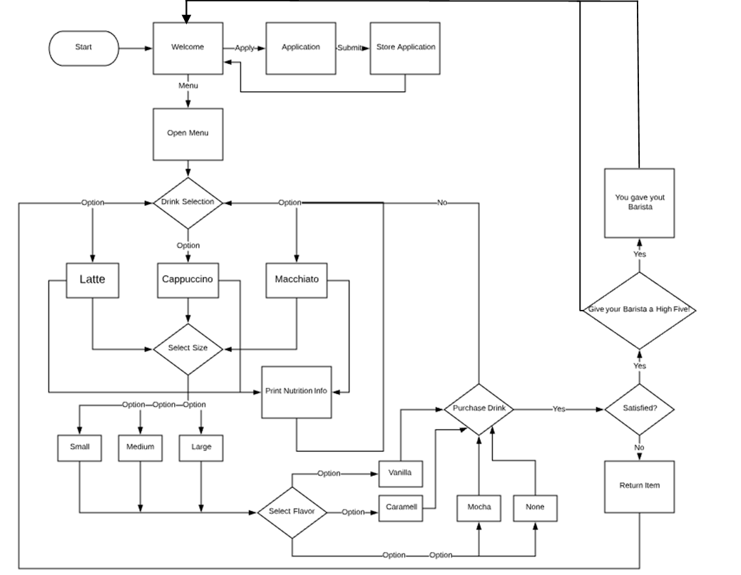

Slide 10
Object Oriented Programming
Without Object Oriented Programming
Define each widget
Redefine them
Create their function

Slide 11
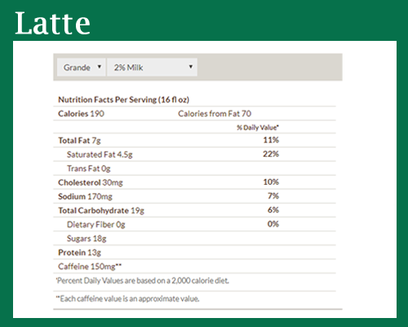

Slide 12
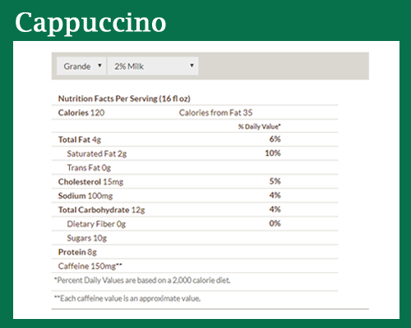

Slide 13
